Slide 1
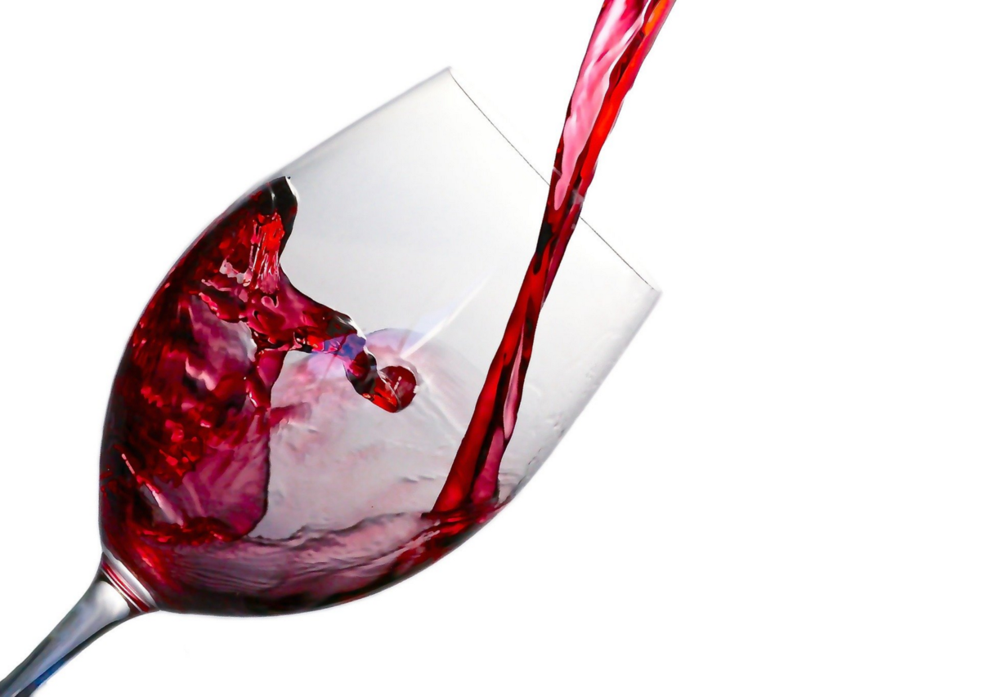
WINE QUALITY PREDICTION
PRESENTED BY
SAHITHI SIRIKONDA - 2103A51291
SUHANI KUSUMA - 2103A51269
FARIHA MAHEEN - 2103A51127

Slide 2
INTRODUCTION
The quality of the wine is a very important part for the consumers as well as the manufacturing industries. Industries are increasing their sales using product quality certification.
As the quality of a product is reviewed at the end of production, it is a time-consuming process, requiring numerous human experts for assessment of quality and is extremely expensive.
The quality of a wine is determined by the input variables like Fixed acidity ,Volatile acidity, Citric acid, Residual sugar, Chlorides, Free sulphur dioxide, Total sulphur dioxide , Density, pH, Sulphates.
Determining good wine quality can result in good health of people.
Determining wine quality in which wine contains antioxidants that might benefit the heart and blood circulation. It used for memory and thinking skills.
Wine quality prediction leads to good quality of wine which prevents diabeties, anxiety and cancer.

Slide 3
ABOUT DATA SET
volatile acidity : Volatile acidity is the gaseous acids present in wine.
fixed acidity : Primary fixed acids found in wine are tartaric, succinic, citric, and malic
residual sugar : Amount of sugar left after fermentation.
citric acid : It is weak organic acid, found in citrus fruits naturally.
Chlorides : Amount of salt present in wine.
free sulphur dioxide : So2 is used for prevention of wine by oxidation and microbial spoilage.
pH : In wine pH is used for checking acidity density .
sulphates : Added sulphites preserve freshness and protect wine from oxidation, and bacteria.
alcohol : Percent of alcohol present in wine.
There are 1600 rows and 12 columns in data set.
y axis is quality of wine .

Slide 4
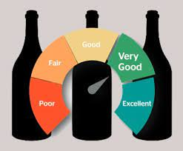
TARGET VARIABLE- QUALITY OF WINE
The final indicators of red wine quality are the intensity and finish. High-quality wines will express intense flavors and a lingering finish, with flavors lasting after you've swallowed the wine. Flavors that disappear immediately can indicate that your wine is of moderate quality at best.
RISERVA .This term indicates the winery has full confidence this wine has high potential and shows their best quality.

Slide 5
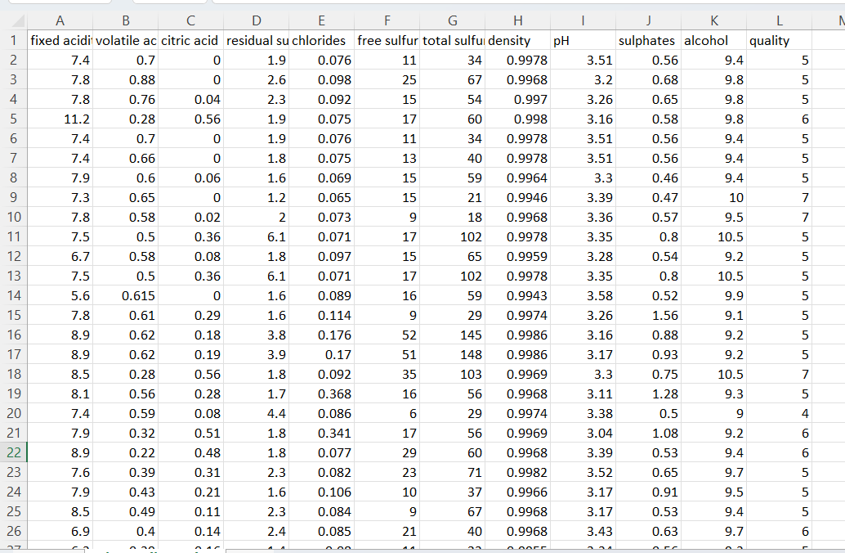
DATA SET

Slide 6
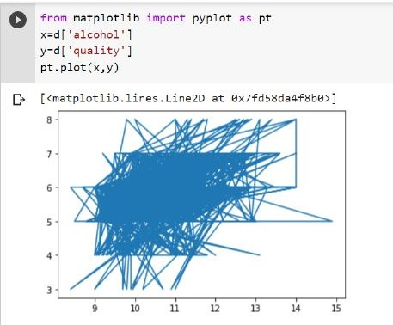
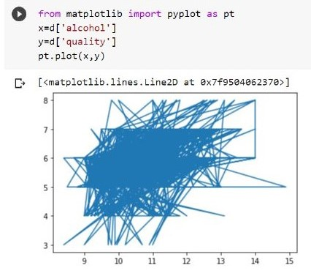
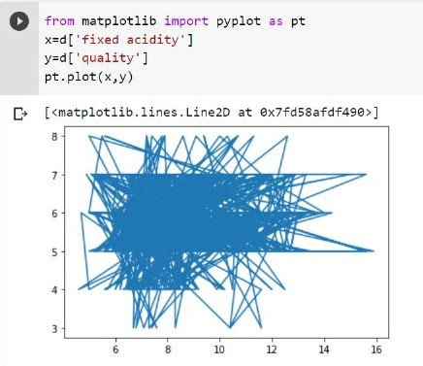

Slide 7
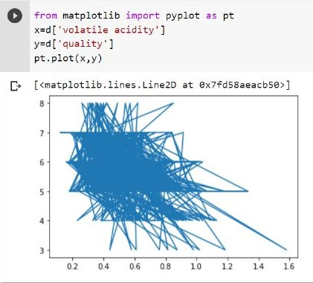
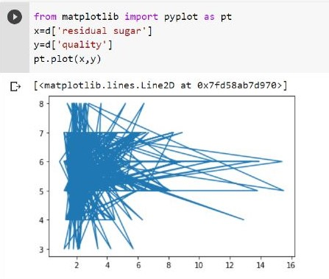
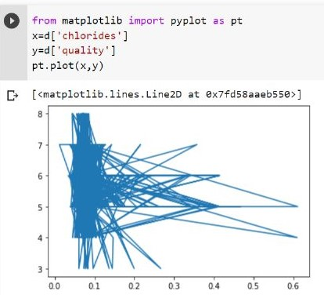

Slide 8
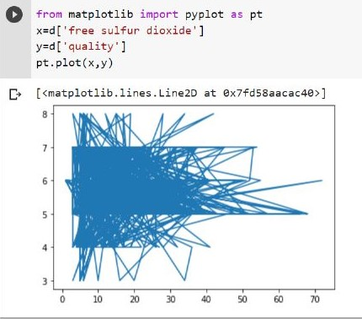
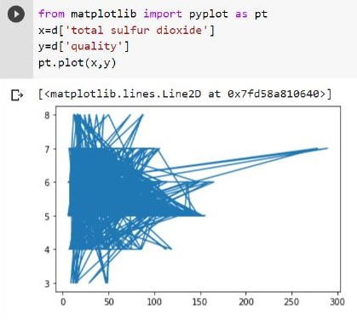
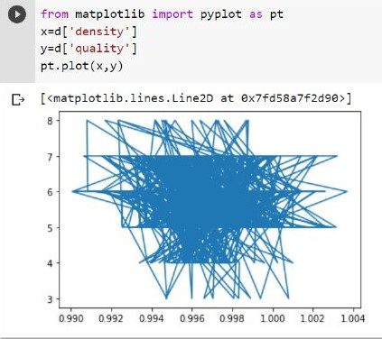
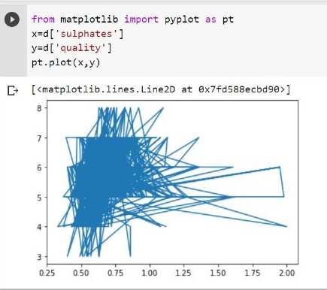

Slide 9
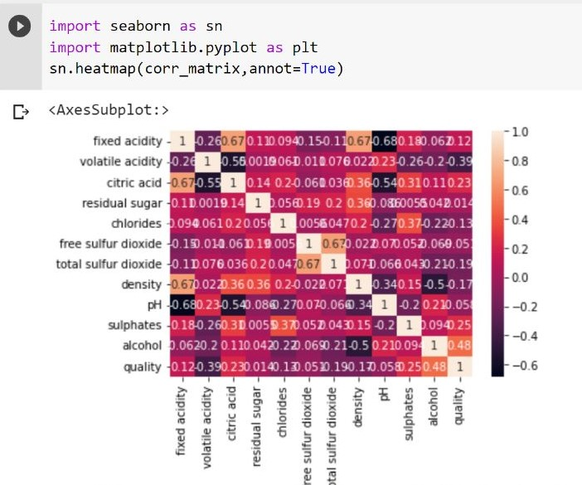
Corelation matrix

Slide 10
WORKING
A simple strategy begins with collecting and preparing wine data, followed by determining the most accurate and effective classification approach from ML methods.
A machine learning classifier takes some input data and tries to predict whether it is low-quality wine, mediocre wine, or high-quality wine.
By using our dataset, we must train our machine learning model, which involves Data analysis and Data Preprocessing. Data analysis selects only the most important data from a dataset.
The purpose of Data Preprocessing is to transform the data into our Machine Learning model so that it will be compatible
As we apply multiple Regression and Classification models to check the accuracy score, the Random Forest Classifier gives us the best accuracy compared to other models, so we will use that model.

Slide 11
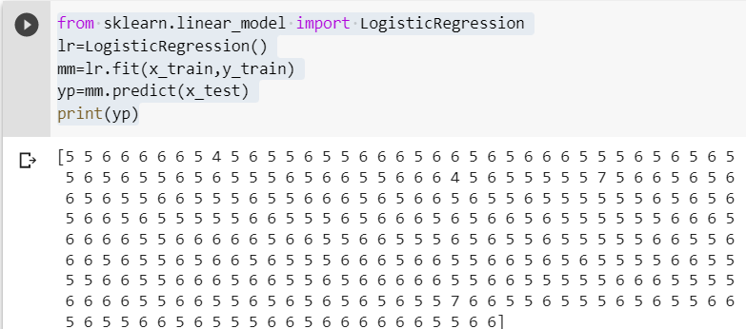
THE ALGORITHMS USED HERE ARE
LOGISTIC REGRESSION:

Slide 12
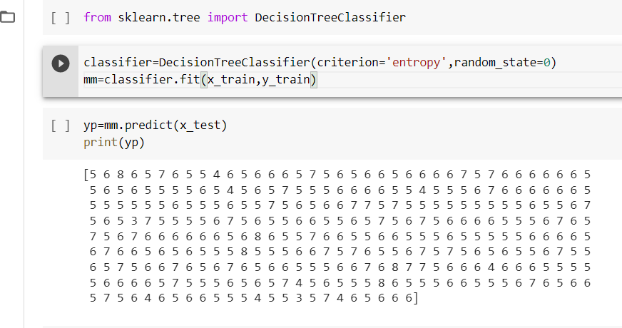
2.DECISION TREE:

Slide 13
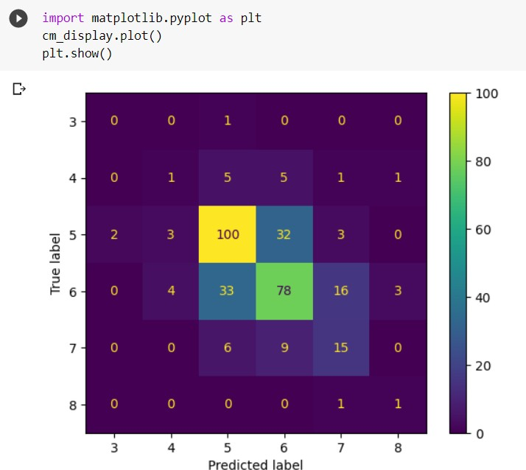

Slide 14
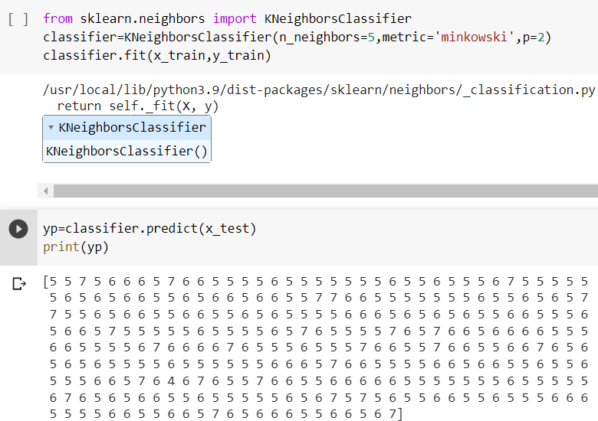
3.K-NEAREST NEIGHBOUR:

Slide 15
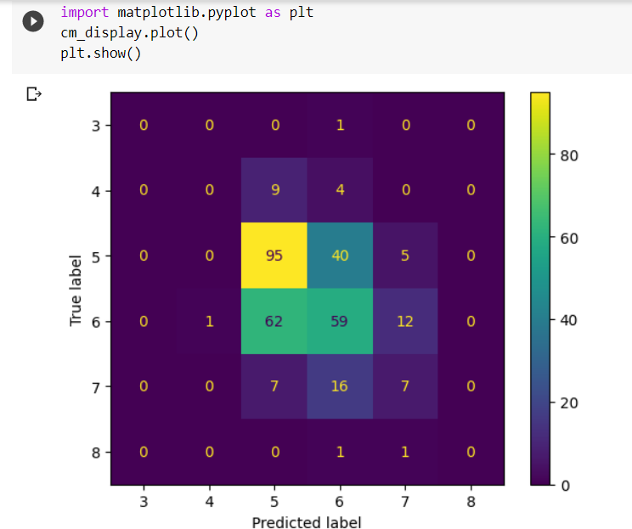

Slide 16
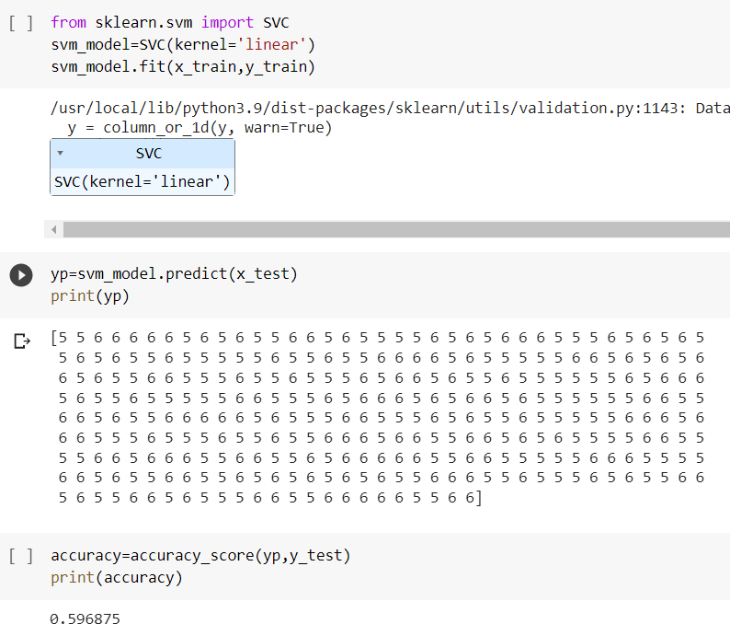
SUPPORT VECTOR MACHINE:

Slide 17
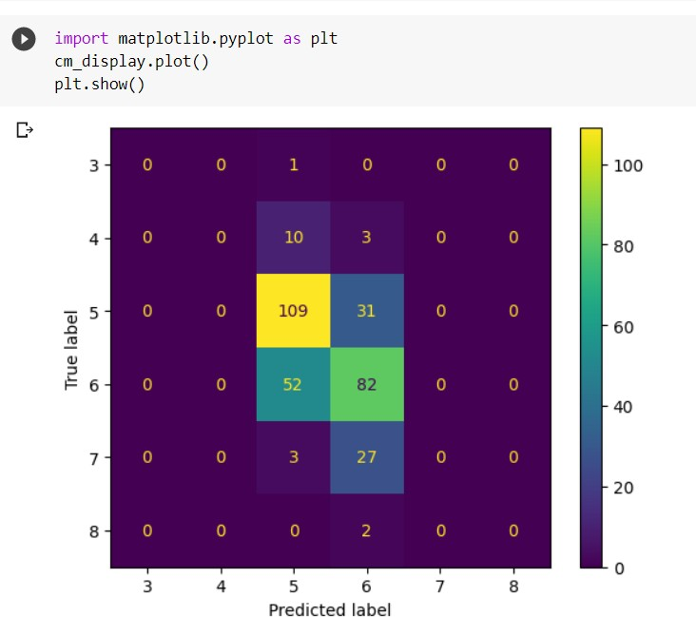

Slide 18
CONCLUSION
With the invention of machine learning techniques, the process has become much more efficient and takes a lot less time.
A number of machine learning techniques and models were used to assess the quality of wine according to the attributes it depends on.
These models enhance the effectiveness of the quality assessment process for the manufacturing industry which has a tremendous impact on our economy.
This project aims to determine which features are the best quality red wine indicators and generate insights into each of these factors to our model’s red wine quality.

